Slide 1

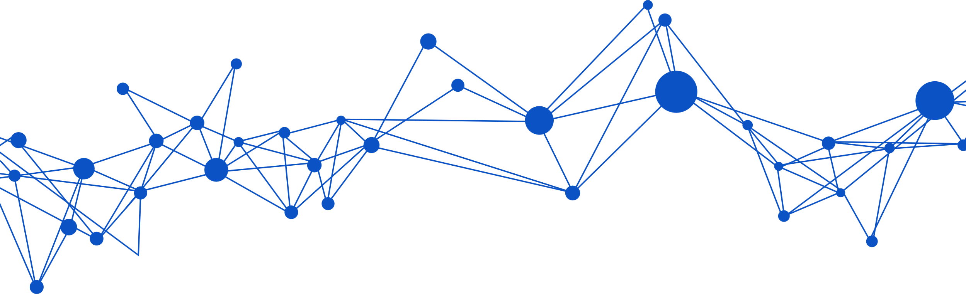
Modeling and Simulation of Mechatronic Systems
Design of an UR5 robotic manipulator in 20Sim
PRESENTED BY:
Francesco Baldassarre
Riccardo Legnini
Samuele Rosato
01

Slide 2
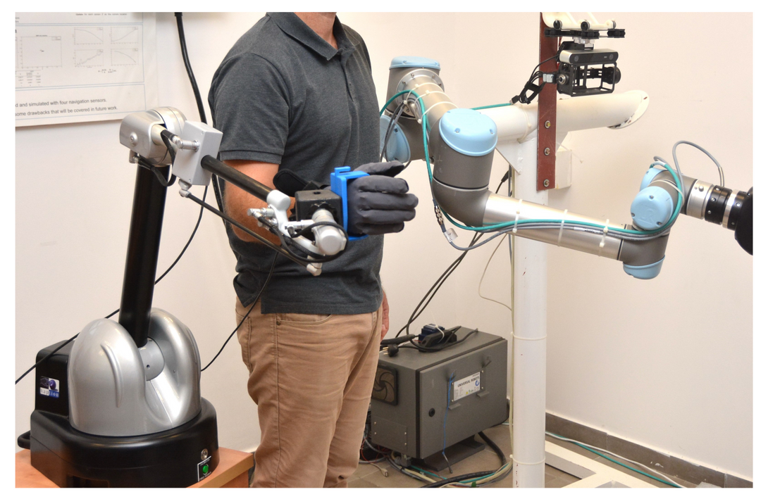
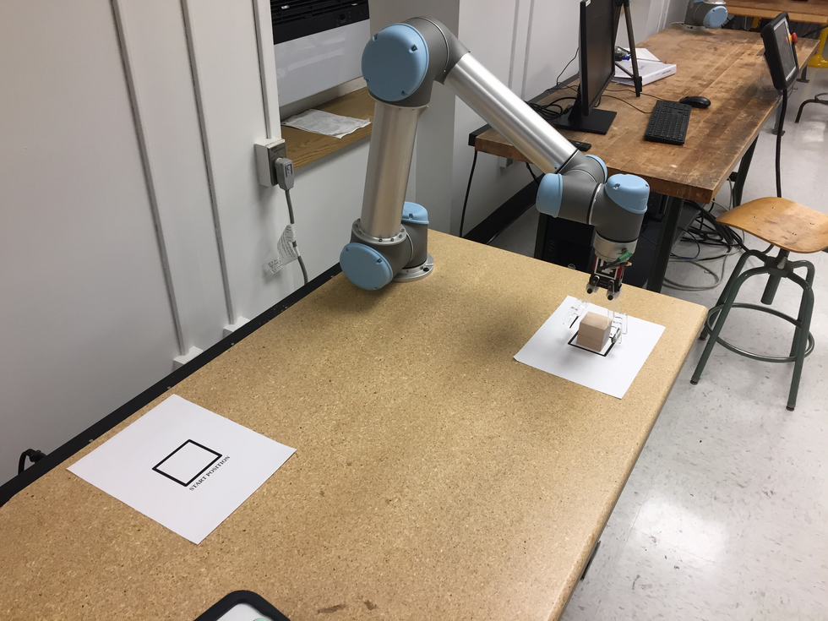
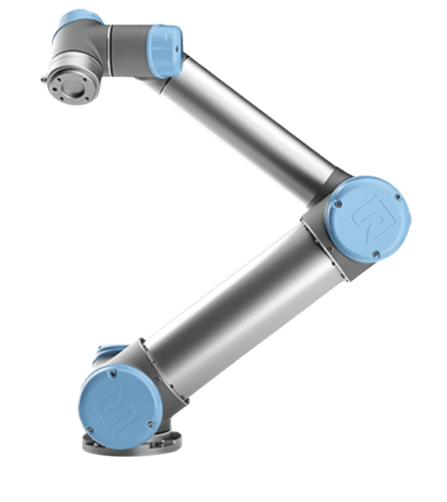
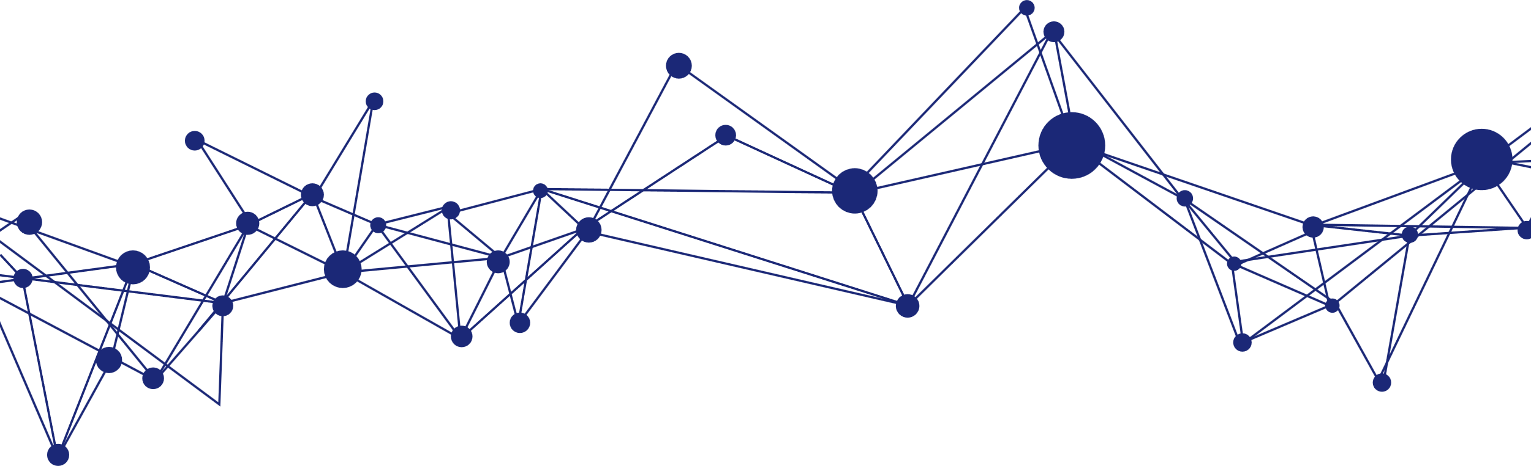
Introduction to UR5
6 degree of freedom
Serial manufacturing
Handling materials
Tele-operations
Goal: design, control and simulate a 20sim model of the UR5
02

Slide 3
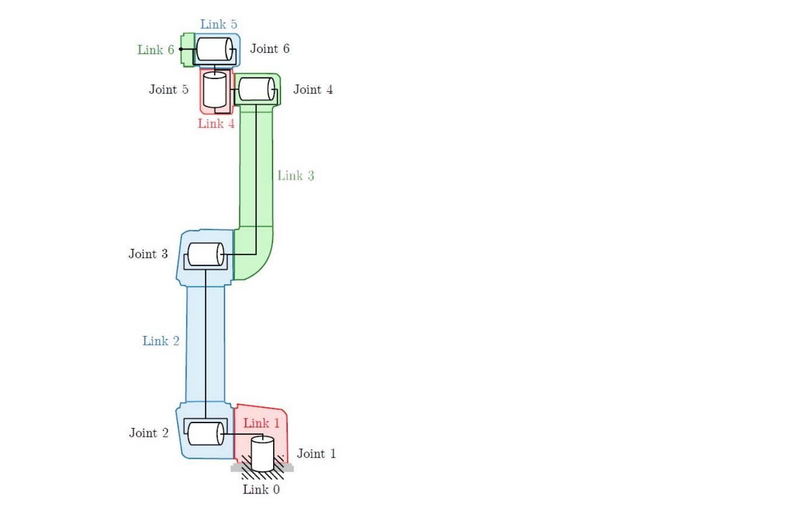
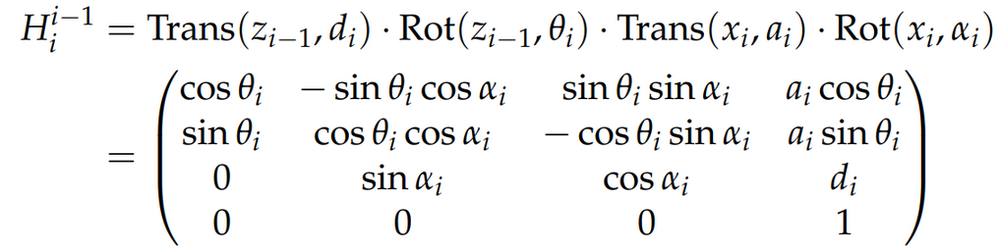
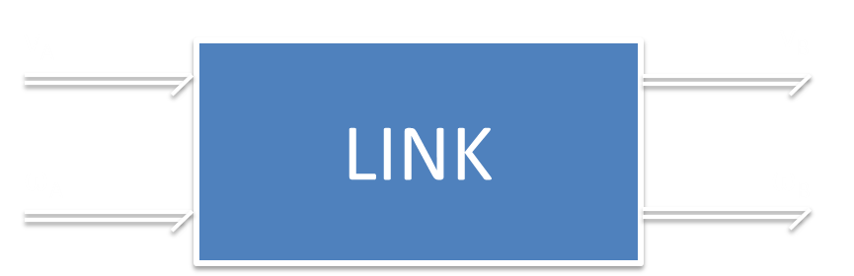
Kinematic model
Describes how each link is positioned and oriented with respect to the previous one. Denavit Herterberg kinematic model has been exploited:
A is the point of link i in which joint i is attached
B is the point of link i in which joint i+1 is attacched
03

Slide 4

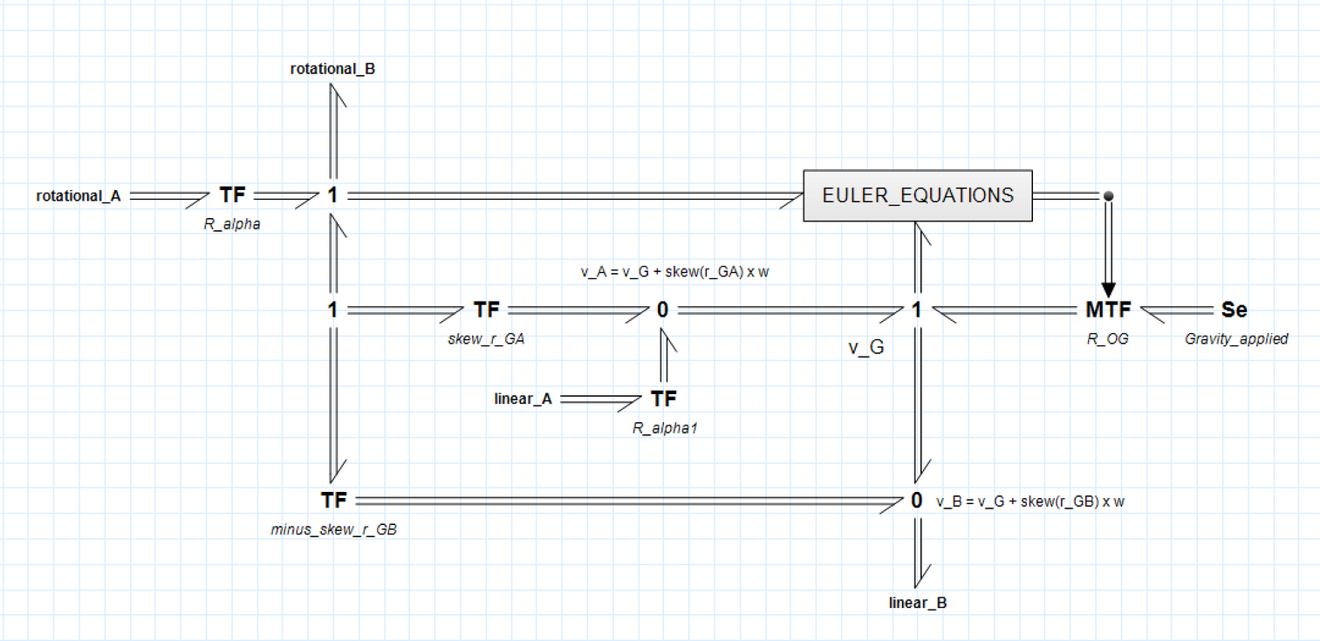
Link model
Inputs: linear and rotational velocities from the previous joint
TF (R_alpha): transformation from the joint frame to the link frame
Euler Equations Block: integration of the forces/torques to obtain the new position/orientation of G
MTF: add the gravity force along the correct direction
Outputs: linear and rotational velocities of point B
04

Slide 5







New rotation/position matrices
Dynamic model
$$R_{OG}={R_{OG}}_{0}+\int_{ }^{ }{R_{OG} Skew\left(ω\right) dt}$$
Takes into account the mass and the intertia of each link, to compute the actual movements when forces/torques are applied.
$$P_{OG}={P_{OG}}_{0}+\int_{ }^{ }{R_{OG} v dt}$$
Newton-Euler Equations:
Velocities of the center of mass
05

Slide 6
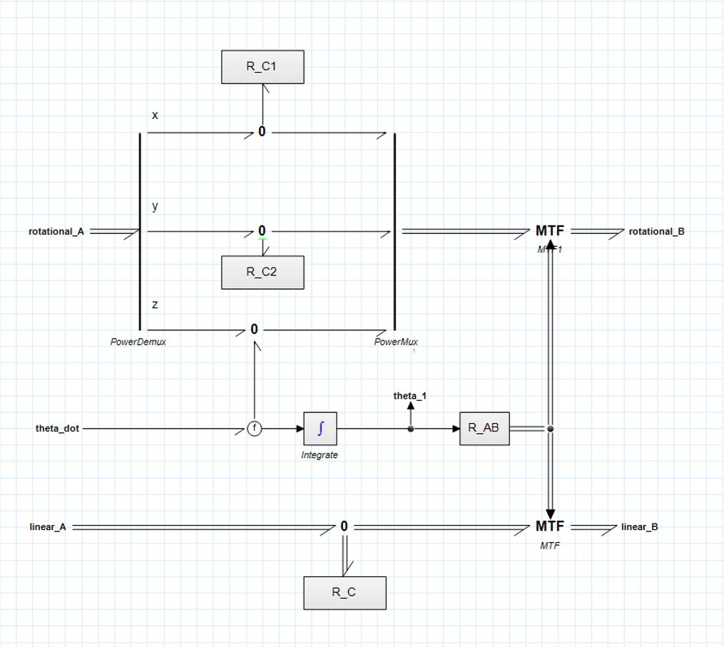

Joint model
Inputs: linear and rotational velocities from the previous link. Joint velocity (theta_dot) from the Harmonic Drive
R_C Block: necessary to constrain the rotation about x and y, and the translational velocity
0 Junction: sum of rotational velocity with joint velocity.
R_AB: rotational matrix between frame of link i and link i+1
Outputs: linear and rotational velocities of point B
06

Slide 7
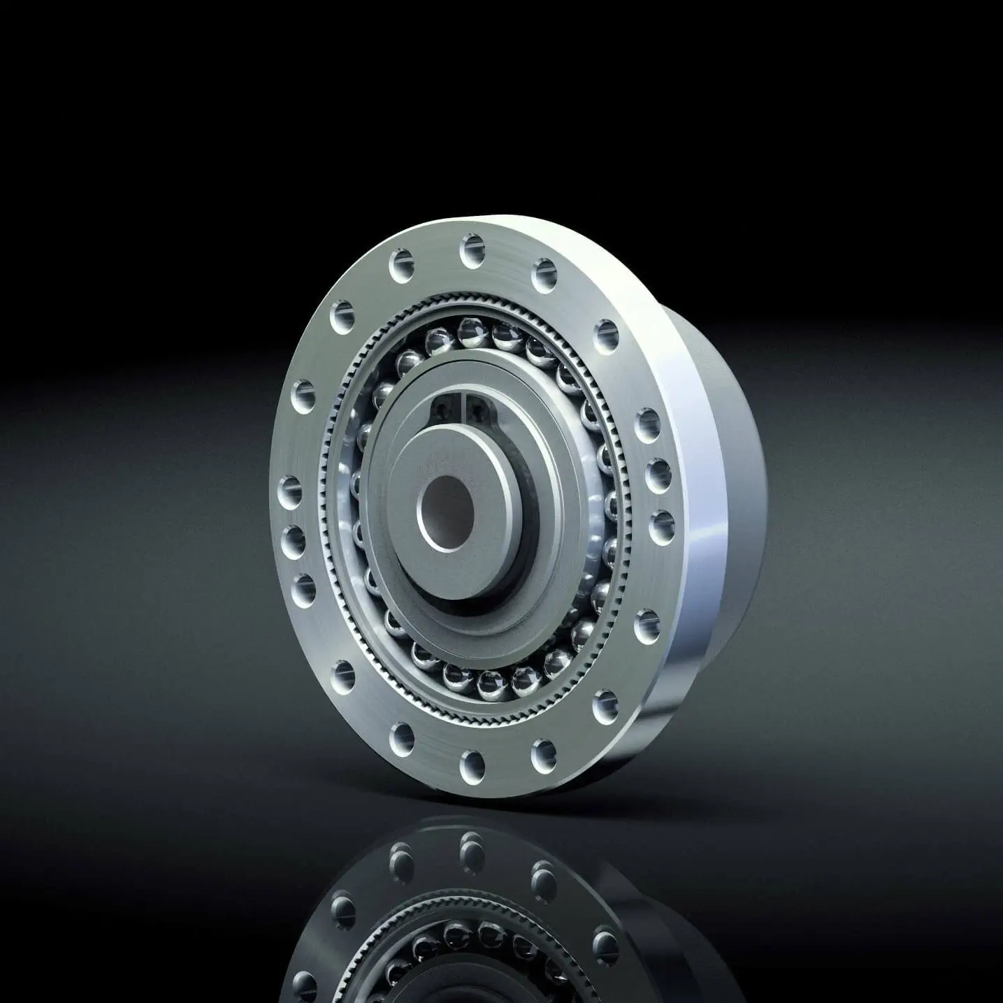

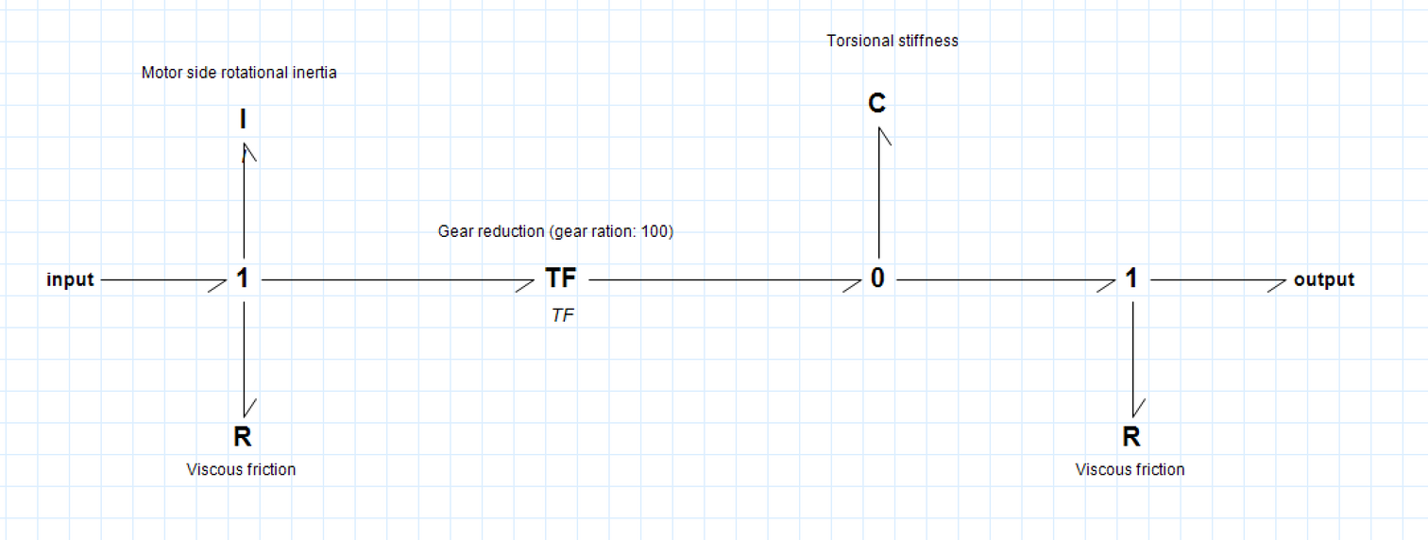
Harmonic Drive
Reduction gearbox
Useful tool to reduce the angular velocity and enhance the torque coming out from an electric motor
I port: needed to model the motor-side rotational inertial
R ports: model the viscous friction inside the Harmonic Drive
C port: models the torsional stifness of the Harmonic Drive
TF: represents the reduction ratio
07

Slide 8
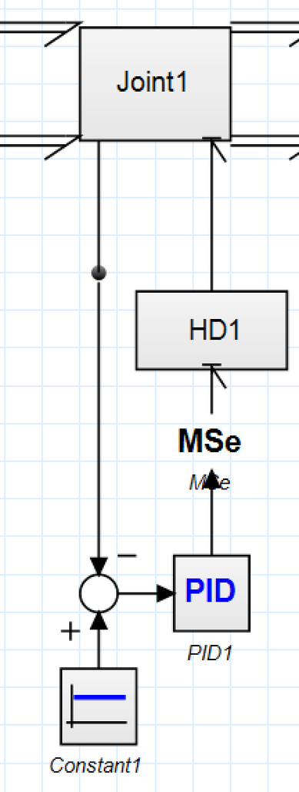




Control action: PID
Derivative time constant
Tameness constant
Integral time constant
Proportional gain
08

Slide 9
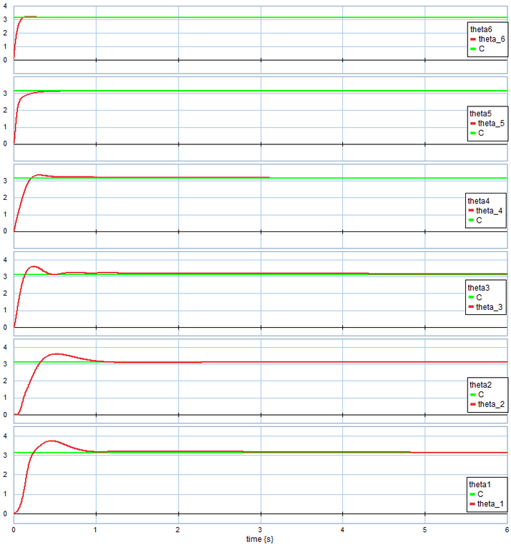
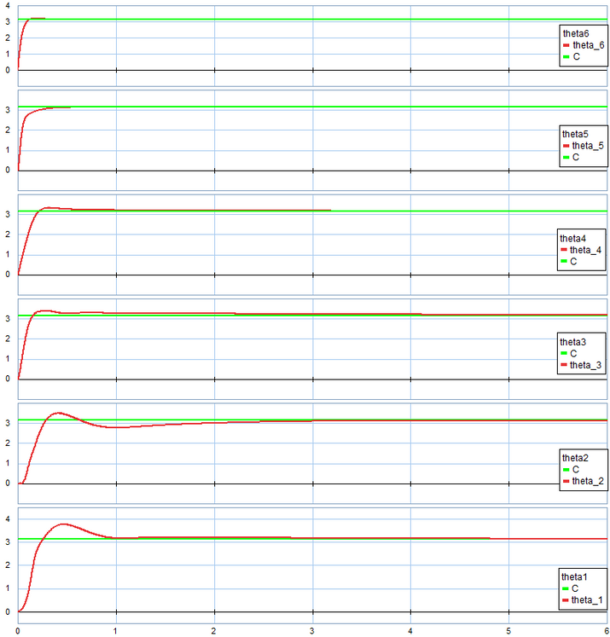
Results
It is possible to notice that the two obtained results are similar for what concerns the asessment time.
Particularly interesting is the overshoot of theta3, which in the second case decreases thanks to the gravity compensation term.
PID
PID + gravity compensation
09

Slide 10

Thank You
For Your Attention

